Slide 1

Algorithmic management

Slide 2
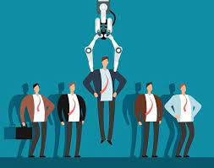
AI-assisted hiring
Potential tasks:
screening and scoring CVs and other application materials, for initial selection of potentially suitable applicants
assessing applicants personal characteristics or interview performance, e.g. verbal and non-verbal responses to interview, specific task performance
Models trained on past employees, proven predictors for performance, agreed quality criteria for specific subject area
Problem of inscribing past biases into models

Slide 3
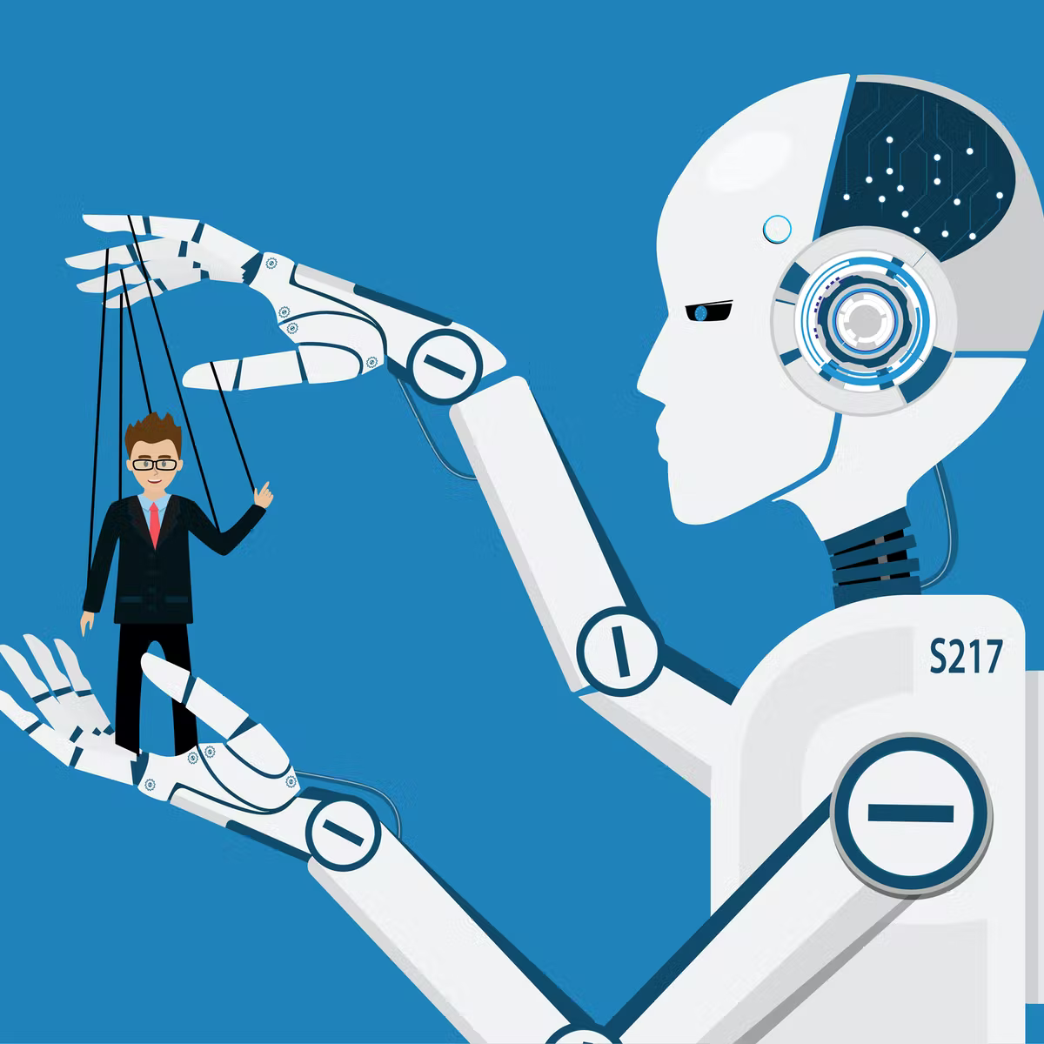
AI allocation and measurement of work
Allocating tasks to suitable workers
Optimising overall work flows and effectiveness
Facilitated through various parameters for incentivisation
Measuring various output parameters and match to system requirements
Example: optimised task schedule for “pickers” in Amazon Warehouses, management of drivers on Uber to meet fluctuating demand
Most prominently in specific work allocation on online service platforms

Slide 4

Workplace surveillance and performance monitoring
Workplace surveillance as “collection and use of data on employee activities in order to facilitate their management”
Including potentially a wide range of data sources, combining strictly relevant data, e.g. browser histories, app use, electronic calendars, data from wearable devices (e.g. fitbits), with integration of wider contextual data (health, social media), and social/emotional parameters
Enforcing compliance with requirements and desirables, e.g.
Monitoring desk usage via sensors
Monitoring email traffic, analysing content of emails
Monitoring websites accessed and apps used
Assessing productivity and risk
Time spent on tasks
Performance ratings by customers
Tracking employee moods, correlated to customer satisfaction
Risk indicators

Slide 5
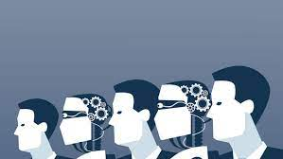
AI-assisted work and collaboration
Co-working with AI, i.e. collaboration human workers and AI
Requires careful design of Human-computer interaction to benefit from strengths of both human and AI and avoid pitfalls
Management of attention and risk of deskilling
Experience of collaboration with AI: tool, assistant, colleague, or overlord?
AI for greater objectivity or human-in-the-loop for accountability?
Question: would it be desirable to design AI as “teammates”; what might be the relational and productivity related effects on workplace practices, experiences and outcomes? (Seeber et al. 2020)

Slide 6

Algorithmic management (Jarrahi et al. 2021)
delegation of managerial functions to algorithms leading to automation of work processes and management functions
reflects and redefines pre-existing roles, relationships, power dynamics, and information exchanges
shapes pre-existing power dynamics between workers and managers
demands new roles and competencies (while also fostering oppositional attitudes toward algorithms)
impacts knowledge and information exchange within an organization with greater levels of opacity

Slide 7

Problems with algorithmic management
The myth of objectivity and hidden embedded values
The AI panopticum
Information asymmetries between AI owner and employee
Lack of human accountability and correction – and risk of marginalising human sense-making and moral imagination (Leicht-Deobald et al. 2019)
Depersonalisation of organisational processes, e.g. HR
“Robotisation” of human employees

Slide 8
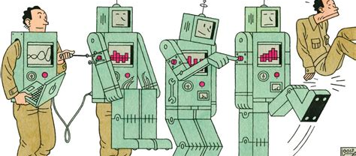
Automation and human labour

Slide 9
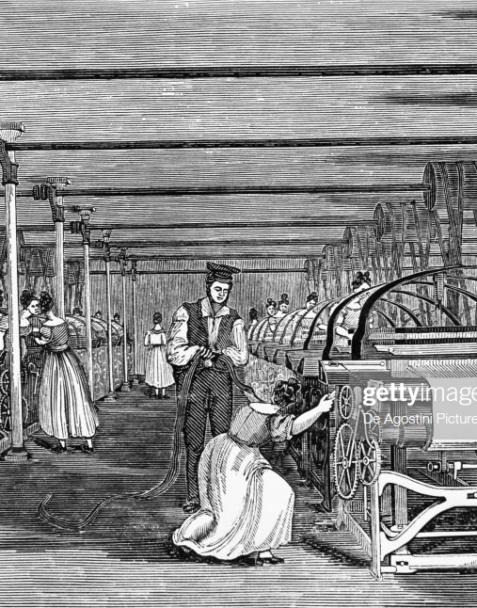
Workplace automation history
Long history of development of technology to optimise the relation between costs and profits, and replace workers with technology (e.g. mechanical looms)
Often associated with splitting complex tasks into simple tasks, associated with deskilling and simplification of previously complex skilled jobs (assembly lines vs lone craftsman)

Slide 10
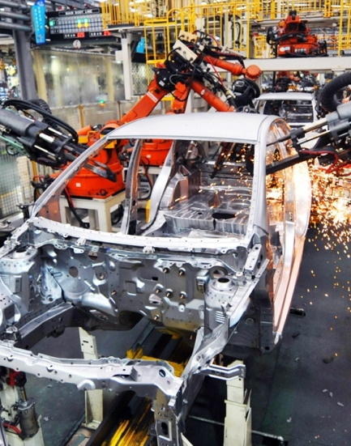
Workplace automation: Industrial robotics
industrial robotics long associated with replacement of workers in performance of specified tasks
Focus in the past on replacement of human workers for repetitive, unhealthy or dangerous tasks
E.g. heavy industrial work, burdensome repetitive tasks, use in danger zones
Now increasingly collaborative work alongside robots, often for more complex and variable tasks and review

Slide 11

Human and machine
“the relationships between man and machine are situated and interdependent, humans will always be in the loop, and reactive policies ignore the need for general guidance for ethical and accountable automation design and implementation” (Jones 2015)

Slide 12
Fair automation principles? (Jones 2015)
Risk: Automated systems should only be deployed with an assessment of risks to human in the loop or humans affected by the loop (including social costs)
Transparency: Automated systems should be comprehensible and support situational risk awareness through effective transparency (no black boxes)
Errors and limitations: Automated systems failures should not be surprising, silent or irresolvable; attentional aspects for human in the loop need to be considered
Diversity and discrimination: Automated systems should reflect on biases and choices during design and test for discriminatory impacts and diverse users
Sensitive situations: automated systems should account for sensitive situations and information preferences for humans in the loop
Man-machine comparison: automated systems‘ design and implementation should locate the human in the loop and reassess the impact on the human and larger social values
Predictability: automated systems should be initially and continually inventoried for predictable and unpredictable behaviour

Slide 13
Total vs collaborative displacement (Danaher & Nyholm 2020)
Total replacement: machine replacing all work tasks, with human worker losing their job, while machine performs all tasks previously associated with that job.
Collaborative displacement: machine replaces some work tasks, but human tasks are retained, retaining work for some humans, now involving collaborating with the machines and redrawing this job’s boundaries
Supervisory or directive collaboration: human creates or manages plans that machine implements, responsible for creative and intellectual work
Maintenance collaboration: maintaining the functioning of machine, via technical maintenance skills
Order-following collaboration: machine imposes tasks on humans (based on human programming, or AI development)

Slide 14
Workplace automation and replacement of workers: current concerns
Previously: automation for physical routine tasks (physical vs cognitive and routine vs non-routine tasks, Autor 2003)
Now: computers increasingly perform well in a wide range of cognitive and non-routine tasks
E.g. medical diagnosis, paralegal work, monitoring of sensitive activities (flights, ICU), financial advice
Robots and AI increasingly as co-workers (“augmented collaborative workforce”)
High skilled workers have moved down the occupational ladder, pushing lower skilled workers further down or out of labour force (Beaudry 2013)

Slide 15
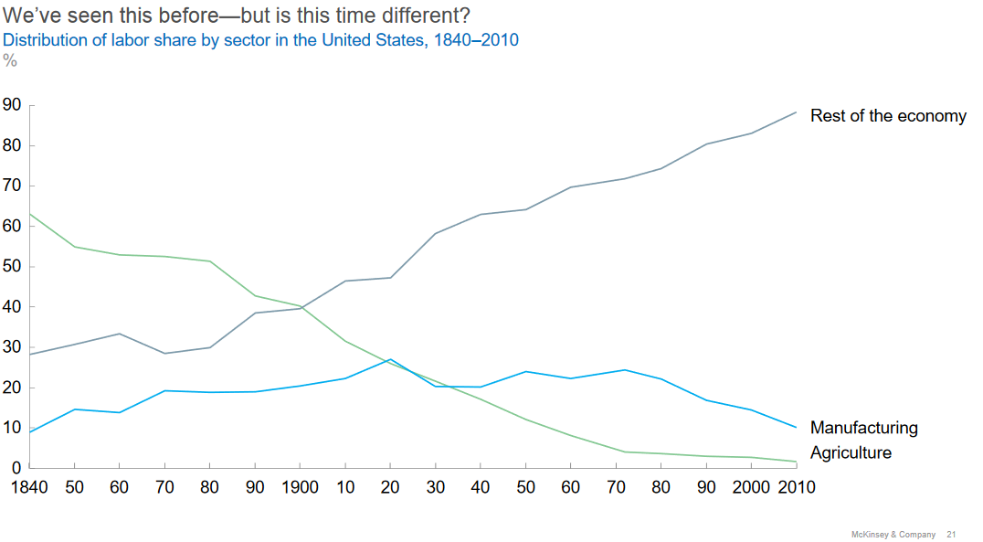

Slide 16
Challenge of inequality
Increasing societal inequalities, associated with social unrest and rise of populism
Automation responsible for increasing polarisation between “lovely and lousy jobs” (Goos & Manning)
i.e. the few at the top with creative, highly qualified work, a heavily decreasing middle with decent, reliable and moderately paid jobs, and the majority at the bottom with often unpleasant, badly paid, precarious and pressurised jobs

Slide 17
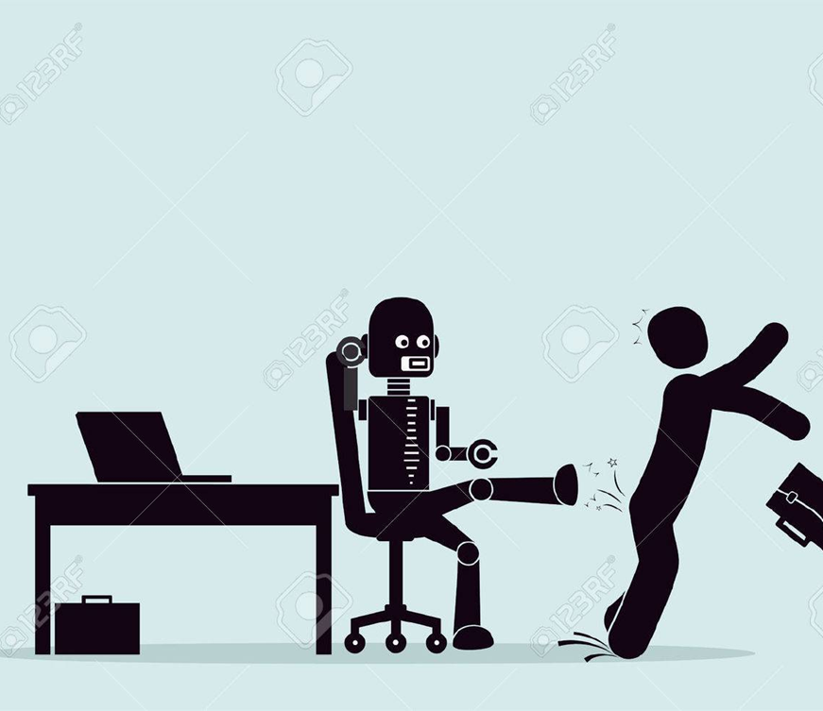
Proposed solutions for widespread human replacement
Training programmes for workers likely to be affected by automation
Universal basic income
Robot or AI taxes, i.e. taxing companies that employ robots or AI – problem: how to identify the types of automating technology that deserve these taxes (especially if not embodied)?
De-privatise benefits of automating technology

Slide 18

Platform labour and the gig economy

Slide 19
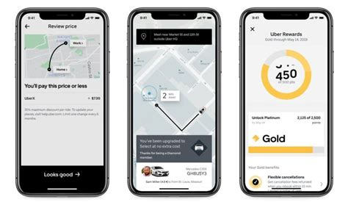



Features of platforms in gig economy
Automating management and allocation of work instead of automating work itself, “on demand” labour
Platforms as intermediaries that organise markets through matchmaking between someone who wants a task done and someone who can perform the task, taking a share of the money changing hands
Cost advantage due to task specific contracting rather than employment
Often aiming for network effects by providing an infrastructure that might be dominant in certain domains or locations

Slide 20

Relation humans and AI on platforms
AI on platforms:
Govern human work tasks (e.g. through optimising delivery and allocating human work tasks)
Adapt models depending on what happens in performance of tasks
Human platform workers:
Primarily: perform work allocated by AI
Some contribute substantially to AI performing its tasks (e.g. through microtasks for data gathering, labelling/annotating, content moderation, checking AI outputs) (Tubaro et al. 2020)

Slide 21
Platforms’ paradoxical self-understanding
On the one hand goal of revolutionising practices in a particular domain, on the other hand denial that truly operating in that domain
"Uber is not a transport company, we don’t own cars. We don’t employ drivers. What we are is a technology platform.“ (Marc McGann, Uber’s Head of Public Policy in Europe, 2015)
But: significant past ventures into self-driving cars and heavy goods transport
Responsible for platform workers‘ work allocation, work conditions and frequently remuneration levels are algorithmically governed by the platforms
Responsibilisation of workers as contractors, frequent denials of responsibility by mediating platforms for concerns regarding work practices and remuneration (similarity to management of issues in social media)

Slide 22
Common features of platform labour
Increasingly precarious work conditions
Assumptions of independence of contractors, but in some domains bound heavily to specific platforms, e.g. due to local availability, or due to platforms requirements, e.g. task offering based on engagement and reputation mechanisms (ratings, experience level, continuous availability)
Only paid for time on tasks rather than availability (1/3 waiting), arbitrary varying payment levels, no social security, no unemployment contribution, no mileage/expenses for drivers
Pay rates under pressure across platforms, below average minimum wage, insufficient availability of tasks, at times underbidding

Slide 23
Crowdwork and worker‘s powerlessness
Customer ratings as often capricious, but consequential for workers
Crowdwork and uncontestable rejections of tasks open to abuse by malicious operators
Crowdwork and systematic underestimation of time for tasks
At times fraudulent activity, e.g. providing clicks for sites, writing fake positive reviews
Main burden and risks falling on workers, one-directionality of sanctions
Bottom-up attempts at workers‘ organisation through platform related forums

Slide 24
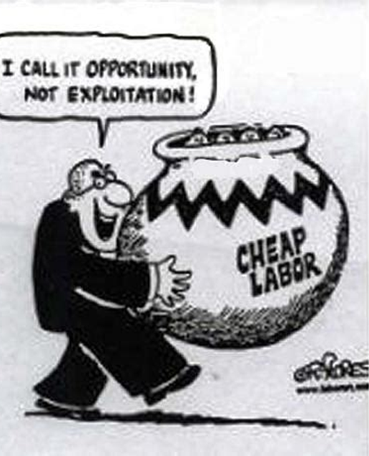
What is exploitation? (Zwolinski & Wertheimer 2016)
taking unfair advantage of someone
using someone’s vulnerability for one’s own benefit, and leaving them worse off than they should have been
Requires power differential and dominance by exploiter
compatible with someone voluntary seeking out exploitative set-up (e.g. if exploitative jobs are the only ones available and “better than nothing”)
exploitation can be transactional (particular exploitative interaction between two parties) or structural (system designed to exploit)
Marxism as one of the most prominent theories of exploitation: value extraction from workers for payment significantly below the value of their labour (“forced appropriation by capitalists of the surplus value produced by workers”)

Slide 25
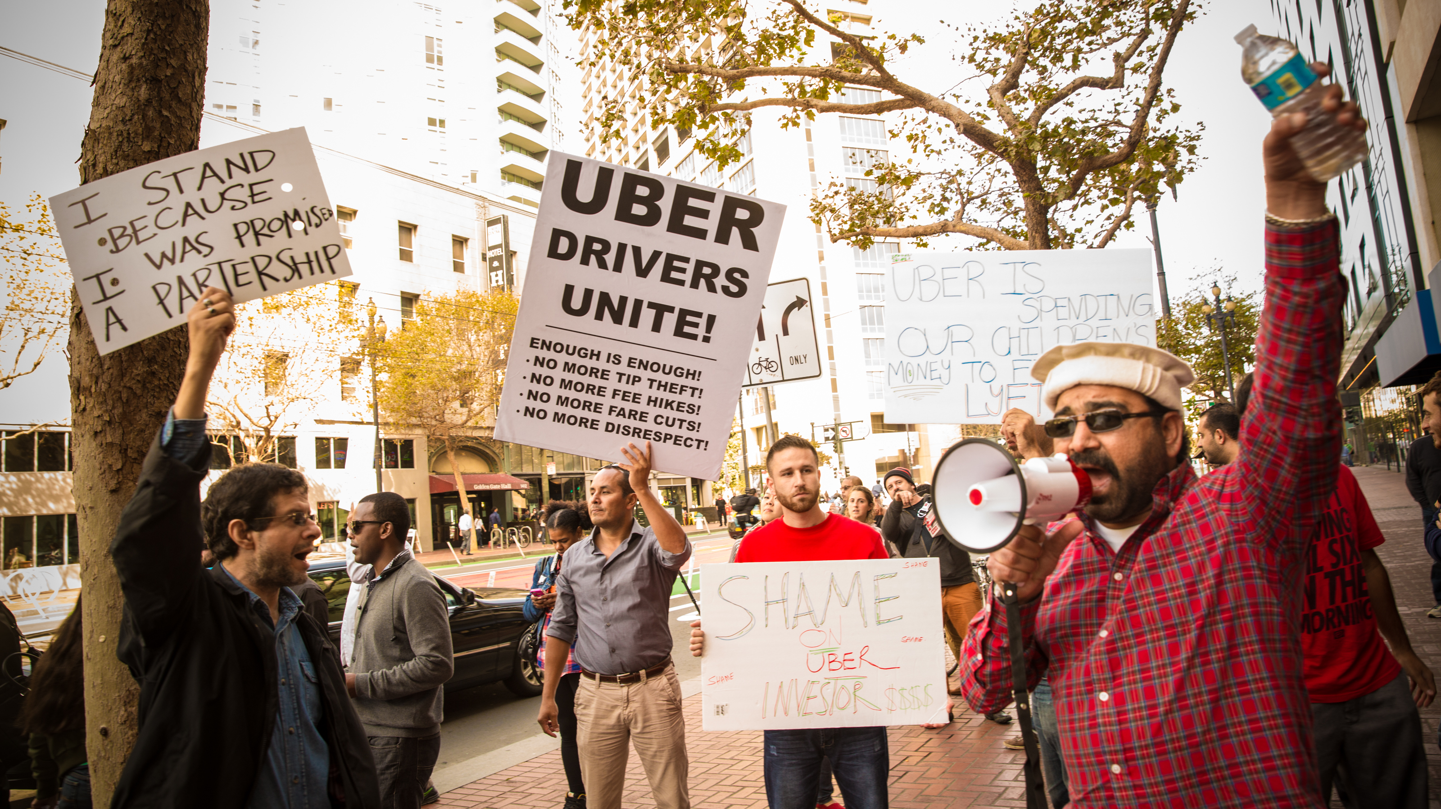
General features of exploitation in platform work
Vulnerability: workers often without access to alternative employment, or with jobs that are insufficiently paid an require additional top-up with platform labour
Leaving workers off worse than they should have been: Remuneration lower than minimal wage, no benefits, unpredictability of work availability and income
Power differential and domination: Opacity of allocation systems, no rights of correction or response, unpredictable and unaccountable sanctions, unilateral responsibilities
Structural exploitation: Limited freedom to move labour elsewhere, largely comparable conditions across platform

Slide 26
Meaningful work in AI-assisted workplaces

Slide 27
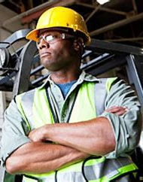
Defining work
performance of an agreed set of tasks
in exchange for payment
regulated by a contract
regulated by certain social norms
significant part of waking hours may be spent on work

Slide 28
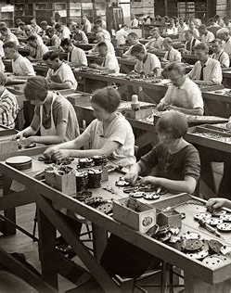
Veltman (2016) on elements of meaningful work
Developing human capabilities
Supporting development and sustaining variety of virtues
Providing purpose, including social and interpersonal recognition and production of something of enduring value
Connecting worker to social or environmental contexts that they care about („something bigger than you“)
(Gender and marginalisation as relevant features)

Slide 29
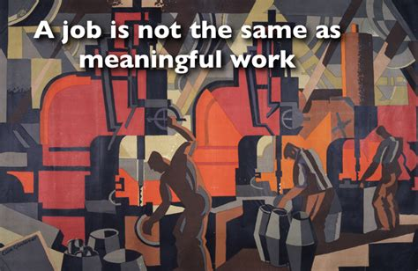
5 aspects of meaningful work (Smids et al. 2020)
pursuing a purpose
social relationships (mutual support, shared sense of agency)
exercising skills and self-development (knowledge, social and technical skills)
self-esteem and recognition (linked to achievements)
Autonomy (shaping work – “job crafting”, making work-related decisions)

Slide 30

AI/robots and purpose
Threat: if AI/robots take over the most challenging tasks, there may be loss of purpose (e.g. AI-aided radiographers with decreasing contributions to helping patient)
Opportunity: worker may perceive themselves as part of an „AI-human team“ where distinctly human elements remain, and take pride in improved performance of the team, e.g. due to correcting each others‘ errors
Especially if assistance or taking over boring, unpleasant elements of task

Slide 31
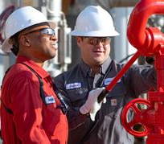
AI/robots and social relationships
Threat: replacement of workers leads to reduction in human contact (empty warehouses), potential isolation, reduction of mutual dependence with other humans, less sense of shared agency
Opportunity: designing AI/robots as „co-workers“ or „team members“ (example Boomer: mine-clearing robot), or designing them to allow them increased interpersonal interaction (e.g. care or educational robots/AI)

Slide 32

AI/robots and exercise of skills & development
Threat: certain human skills might become obsolete when completely replaced by AI/robots, their use may lead to deskilling of previously skilled job (e.g. autoland functions in airplanes), level of commitment needed for performance reduced
Opportunity: might enhance workers‘ need to maintain or increase skills, new skills needed in collaboration with AI/robots; high performance of AI might serve as skills model or benchmark for human skills; AI system might be complex to operate

Slide 33
Automation and the achievement gap (Danaher & Nyholm 2020)
“Achievements are outcomes that are brought about by coordinated human activity in such a way that those outcomes can be linked to the efforts of individual human agents.” (p.4) – linked to responsibility, effort, sustained commitment and praiseworthiness (lottery win vs. sports championship)
“On the 27th of November 2019, Lee Sedol announced his retirement from the professional world of Go-playing. Sedol was an 18-time world champion of the fiendishly difficult Chinese strategy game. He was a long-time celebrity in his home country of South Korea, but attained international notoriety in March 2016 when he was defeated, 4–1, in a five-game challenge match against Alpha Go, an artificially intelligent Go-playing computer program, created by the software company DeepMind. Sedol did not announce his retirement with a sense of satisfaction about what he had achieved in his career. He did so out of a sense of despair. He told reporters that he felt there was no point in continuing with the game because he could no longer compete with the machines. He had come to the realisation that he was no longer “at the top even if [he became] the number one”.” (Danaher & Nyhold 2020, p.1)

Slide 34

AI/robots and workers‘ self-esteem and recognition
Threat: if AI/robots perform the most important part of work pride may suffer, recognition might reduce, qualifications may become worthless, levelling out differences between decent and top performers
Opportunity: co-work with AI/robot might lead to enhancing complex skills, allow more space to realise them (e.g. robot enhanced care allowing space for more complex care tasks)

Slide 35

AI/robots and workers‘ autonomy
Threat: AI/robots that require very strict protocols, where worker have little scope for judgment, decision-making and development, experiences themselves as subordinate to machine, fine-grained monitoring and surveillance of performance, opacity of AI may lead to feeling of alienation
Opportunity: AI/robot collaboration may leave room for human decision-making, open up new avenues of autonomous decision-making, may be perceived as instruments/tools for achievement of purpose,

Slide 36
Autonomy and “order-following collaboration“ between AI/robot and human
Automation and the risk of treating humans as “stimulus-response machine”
“Think, for example, of the Amazon warehouse worker who is given a set of customer orders and a route through the warehouse to pick up those orders that has been planned by an algorithm. They see the stimulus given to them by the machine and respond, not with creativity or foresight, but by just following the route that is recommended. They dare not second-guess the algorithm or exercise any creativity in case they are less efficient at their jobs.” (Danaher & Nyholm 2020, p.7)
(see also John Oliver in Warehouse segment on Amazon workers describing themselves as feeling roboticised)

Slide 37
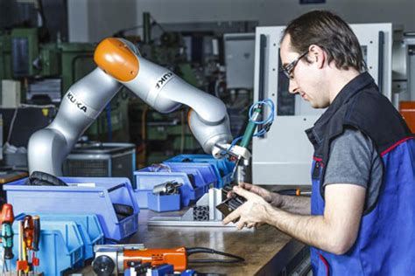
Design for meaningfulness
Full automation vs AI/robot collaboration and society‘s obligation to support availability of meaningful work
Or is it about enabling flourishing outside of work? (e.g. GBI)
Importance of designing AI/robots with impact on meaningful work in mind:
Avoid automating features that are essential for the experience of purpose
Design for maintaining meaningful human contact
Be clear about how skills component for human operators/collaborators links to prior skills, design collaboration with skills aspect in mind
Identify distinctive contribution of humans
Retain opportunities for autonomous decision-making during operation

